Slide 1
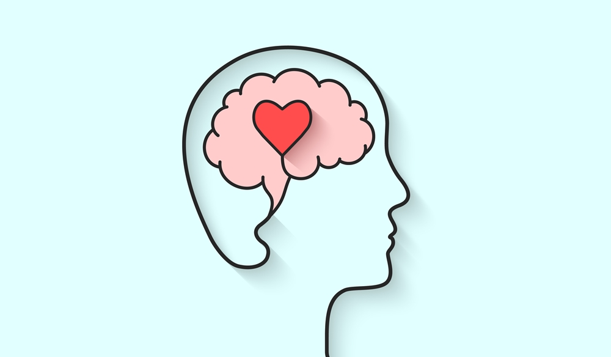
TECHNO-DOTE
ENSURING MENTAL WELL-BEING

Slide 2
Mentor - Dr. Ashish Kumar Sahu
TEAM MEMBERS
SHUBHAM GUPTA - 19BCE10261
ESHUDHI JANGID - 19BCE10401
AYUSHMAAN SINGH RAJPUT - 19BCE10306
PRACHI KUMARI - 19BCE10402

Slide 3
INTRODUCTION
Mental health and emotional wellbeing is one of the most common and debilitating health challenges in the present scenario. Mental health has been observed as the reason for many brutal crimes and sufferings. Psychology is what controls our actions or decisions which may lead us to be a victim or a criminal. Owing to increasing crimes and death where mental health plays a significant role we decided to find a technical solution in this matter and hence visualised a model which can be infused as a mobile application which maximum people have close to them most of the time.
The point is even if someone is thinking of ending one's life, it is very probable that they will surf “easy ways to die”, on google or if someone is dealing with any other issue, the first place they seek help is from an online platform where their identity is concealed. Sharing daily updates with friends and family directly is non-existential and instead all daily life updates are on various social media. Even if an amateur is conspiring for some terror activity or any heinous crime, they may look for examples available on the internet or ways to implement their plan etc.
This makes our visualization more solid. We proposed fitting in a framework in mobile etc. which can scan through the tweets of the user to check for any suspicious activity that leads our machine to think that the referred person is at risk. Also, More than 70% of people in the early stages of depression would not consult the psychological doctors or inform their family.

Slide 4
PROBLEM STATEMENT
Our main motivation for proceeding with this project is the increasing rate of suicide - a 3.4 percent increase was observed in suicides during 2019 (1,39,123 suicides) as compared to 2018 (1,34,516) and 2017 (1,29,887), the data shows. The rate of suicide (incidents per 1 lakh population) rose by 0.2 per cent in 2019 over 2018, as per the data. Also, research reveals that more than half of the human population on the earth has been suffering from depression etc. at some point of their life. In the month of June, news of demise of a great Bollywood actor came across which went through so many conclusions because we had no proper way of determining if the death is by suicide or is actually a murder which is fakely disguised as suicide. This interrupts justice, takes away so much time from the authorities and administration, it also creates huge chaos and an unpleasant environment all around. This incident further pushed us to continue with this idea.
Owing to how conveniently the internet and wide usage of social media have invaded our privacy and are keeping an eye on us every time, what could be better than using it to analyse mental health challenges and prevent any lethal damage to any individual or the society. Also, the main challenge someone suffering with life-taking risk is they fail to ask for help from the right place or share it with their parents and family hence increasing the risk.

Slide 5
OBJECTIVE
The objective of this work is to create a model which can be expanded and infused to be used to bridge the gap between the people at risk and organisations/family who can help. It also aims at reducing not only the death rates due to suicide but also save time to authorities and ensure justice by failing any plan of fake framing of suicide.This will not only help people who are unable to reach out when in need to the family and dear ones but also the investigation department by giving them untampered authentic data in case of any inevitable tragedy.

Slide 6
EXISTING WORK AND LIMITATION
Facebook AI is working on suicide prevention but is limited to providing only a robot asking questions like “Are you fine?” etc. We have apps such as Calm, Breathe2Relax,Happify, etc and many others which focus on mental health, providing a motivational quote every morning in the notifications, having bots to chat but it fails to provide any reliable consolidation to the sufferer. Also, they will not be able to monitor any criminal, revengeful or terror track driving of the mind. Though many bloggers claim that digitally we can curb the unwanted fatal eruption of our mind, we are yet to see any real technology available as of now.
We have applications which work on face detection, voice classification, mood trackers but they are not being used for the identical purpose as ours. The mood trackers are there but with the drawback that one has to feed how they are feeling themselves for the application to give any output which is merely some feel good text or advice which it does not ensure has been followed.
Instagram is also recently showing an option to get help if suffering from depression etc. but again it needs input from the sufferer itself which does not work in most of the cases.

Slide 7
PROPOSED WORK AND METHODOLOGY
Step1: Get twitter sentiments for keywords depression, anxiety, mental health.
Step2: Store twitter sentiments in a text file, Got 3500 tweets.
Step3: Once setup, create a table to store the necessary tweet details. Use Jsonserde to convert the JSON format according to our tables.
Step4: Create a table called tweets_raw table containing the records as received from Twitter.
Step5: Load the time zone file and the dictionary file to the Hadoop file system (hdfs).
Step6: The time zone file contains the time zone and the associated country.
Step7: The dictionary contains words with their polarity. Each word taken from the tweet is compared with the dictionary and given a score.
Step8: The sum of polarity is added for each tweet and if it is above 0, then it is a positive tweet. If it is equal to 0 it is neutral and if lesser than 0 it is a negative tweet.
Step9: Stores as an excel file and fed to python. Here using Naive Bayes classifier to classify tweets as positive or negative and also see the efficiency of the algorithm.
Step10: The data is compared to a suspicious count and if it is greater than the count then the data will be input in a real time database
Step11: Now we will connect our application to the RealTime Database.
Step12: If our application finds any data over that database then it will fire an action commanding to send a message to health care departments and their family members.
Step13: Rather than this our app will also show different types of quotes which will help him/her to heal up faster

Slide 8
NOVELTY OF PROJECT
We have no such existing framework which send an SOS alert in the nearest help centre, police station or the close confidante of the sufferer. Also, most of the frameworks work on the basis of inputs provided by the sufferers themselves which does not work most of the time as it is highly unlikely of a person suffering from mental health issues to accept it and ask for help. A major highlight is a heal-o-chatbot kind of things or daily motivational quotes may help initially to lift moods at times but fails to prevent the actual damage. Keeping all this in mind, we thought of a real solution where the risk is calculated automatically with help of the person’s daily online social media activity and send an emergency message if things are found vulnerable.

Slide 9
REAL TIME USAGE
NDTV claims that India has reported an average of 381 deaths by suicide daily in the year 2019. One of the major use of this project will be in curbing the rate of suicide and let help reach to people when they are alive and the tragedy can be avoided. Also, murderers can escape very easily by falsely framing their crime into a suicide case, this project can help by providing the real information and factual data of the victim and may be let us know the callous motive of the criminal even before the crime has occured. Crimes nowadays occur most of the time with help of technology, in such a case if our police and other administration departments have advanced technologies as their backup, their work can be efficient, chances of blunders and corruption will be readily reduced.

Slide 10
HARDWARE AND SOFTWARE REQUIREMENTS
Hardware Requirement :
Mobile Phone,Coding medium( A basic Laptop)
Software Requirement ;
Google Colab, Pycharm,Github, Kaggle, Twitter API, Android Studio

Slide 11
LITERATURE REVIEW
The project targets the society of all age groups. As per the data acquired from google, all age groups are vulnerable for mental health issues who use technology specially phone,tab, laptop etc.
Adobe Social Analytics basically measures the impact of social media on businesses by understanding how conversations on social networks and online communities influence marketing performance.
Social Mention is a social media search and analysis platform which analyses user sentiments through social media. This is also an online tool that allows tracking what people are saying about a particular brand, product or topic in real time. This tool allows the user to define a time period in which to analyze user sentiments.
TweetFeel is also a web tool that analyzes sentiments of the given input through the twitter social media. This gathers real time data on Twitter, about the search items and evaluates those tweets into positive and negative categories in real time. This uses machine learning based sentiment analysis which enables us to get much clearer feelings about sentiments.

Slide 12
Initial Algorithm
START
Read data(x)
YES
x == trigger?
frequency ++
NO
No
frequency>= threshold?
Next line()
SEND ALERT
YES
Notes:
Prachi

Slide 13
MODULE WORKFLOW AND EXPLANATION
Firstly we prepared the python code which worked for a proposed idea. Afterwards when it was time to link social media platforms , we were only able to connect twitter with a twitter developers account which gets some preproproposed data to work on. We get twitter sentiments for keywords depression, anxiety, mental health,Store twitter sentiments in a text file, Got 3500 tweets.We compared the pre-proposed data saved to “TWEETDATA.txt” with the prepared dictionary named “DICTIONARY.tsv” consisting of vulnerable words and texts we found while the research work and marked the the vulnerable tweets with ‘-1’ and safe tweets with ‘1’ and saved the data in excel sheet “SENTIMENTS 2.xlxs”. Now we counted the total numbers of ‘-1’s in the python code, If the count is greater then the 3/4th of the total tweet counts, then a key word ‘1’ will be uploaded to the Firebase Realtime Database . Now the android application will retrieve the uploaded data as a string and compare it with setted value ‘1’. If the output is true then a message will be sent to the respective family members and in some cases to the related authorities.The application consists of few more operations for the convenience of the user.The app contains two buttons ,one for SOS call and second for SOS message, followed by two menu options , One for online government website for Mental Health related issues and other for activity containing MAHANAGAR helpline numbers (MAHANAGAR includes Delhi ,Mumbai, Kolkata ,Chennai).

Slide 14
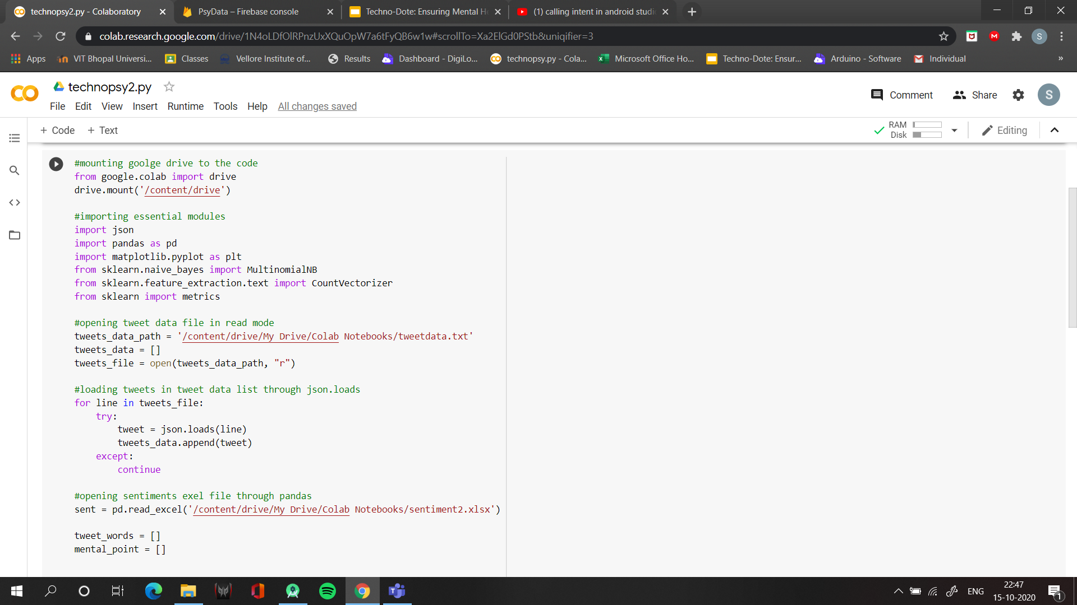
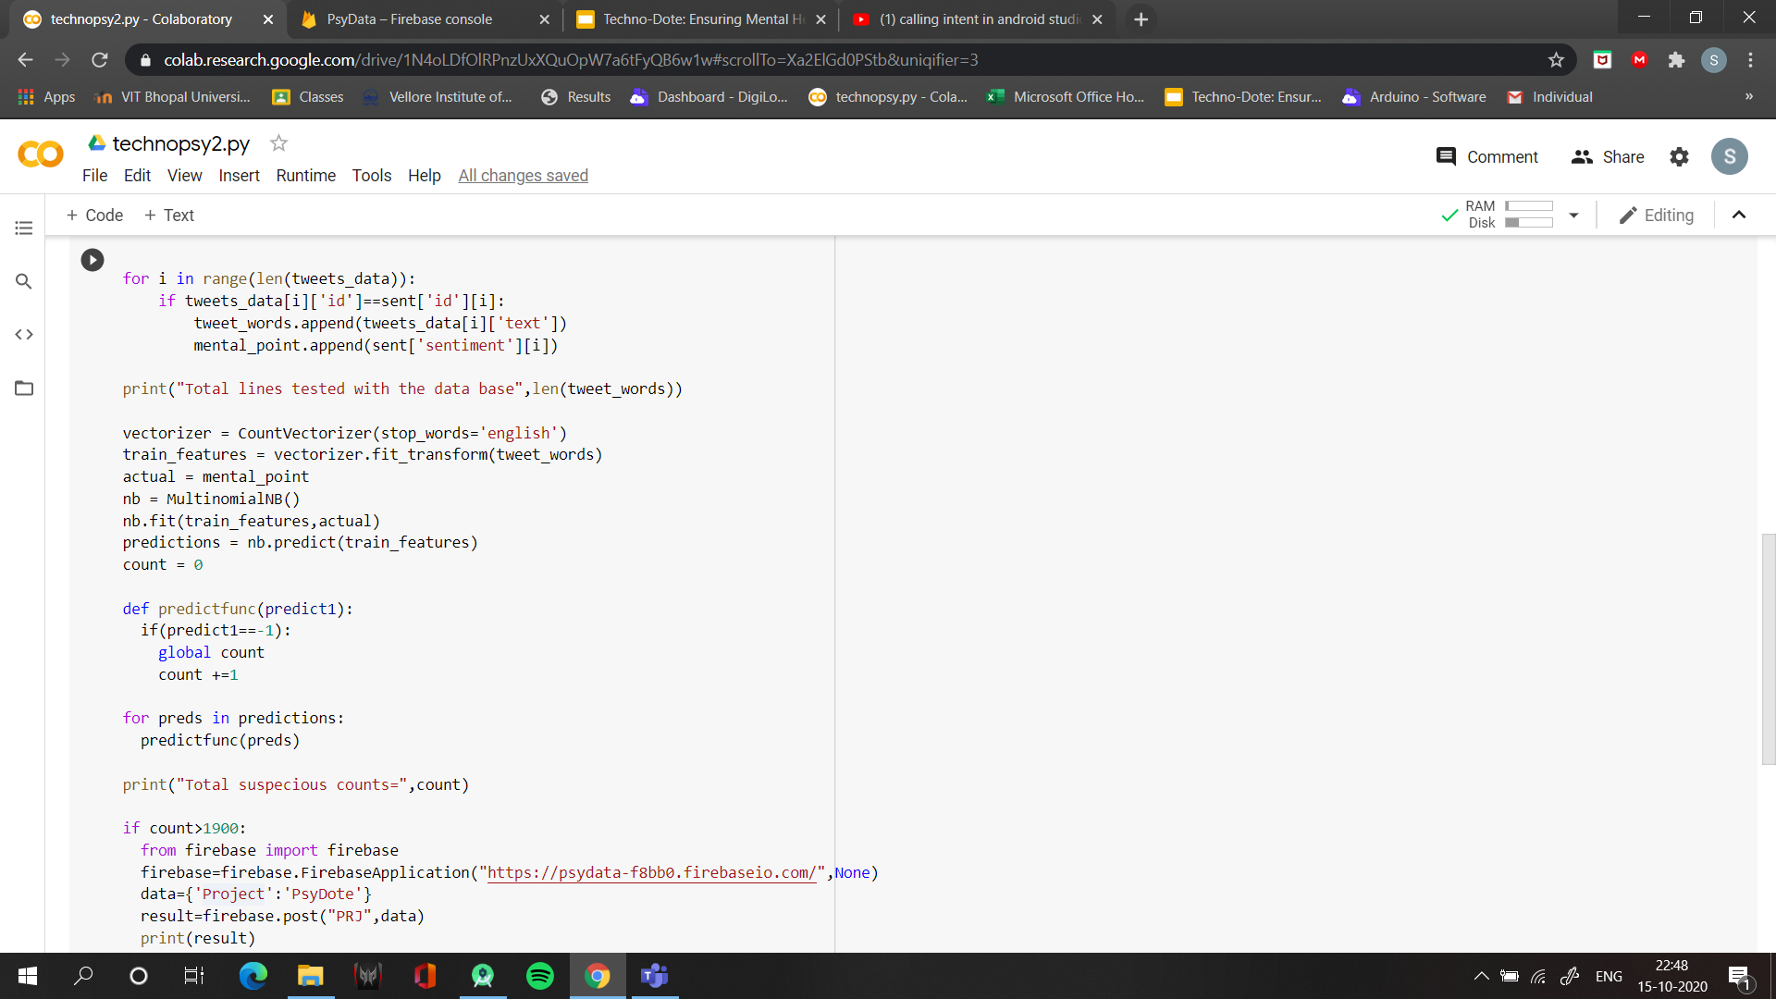
Python Code reading the Tweets from Tweetdata.txt and comparing data to sentiments.xlsx to detect vulnerable words and data.

Slide 15
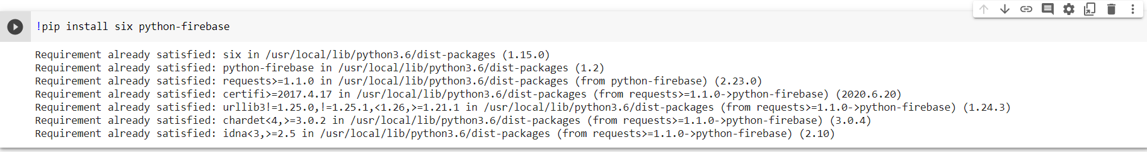
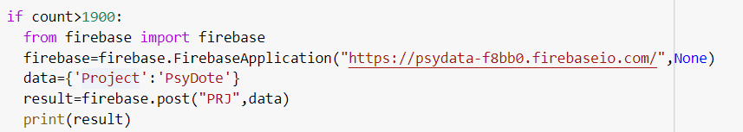
The Firebase connection of Python to a Realtime database.

Slide 16
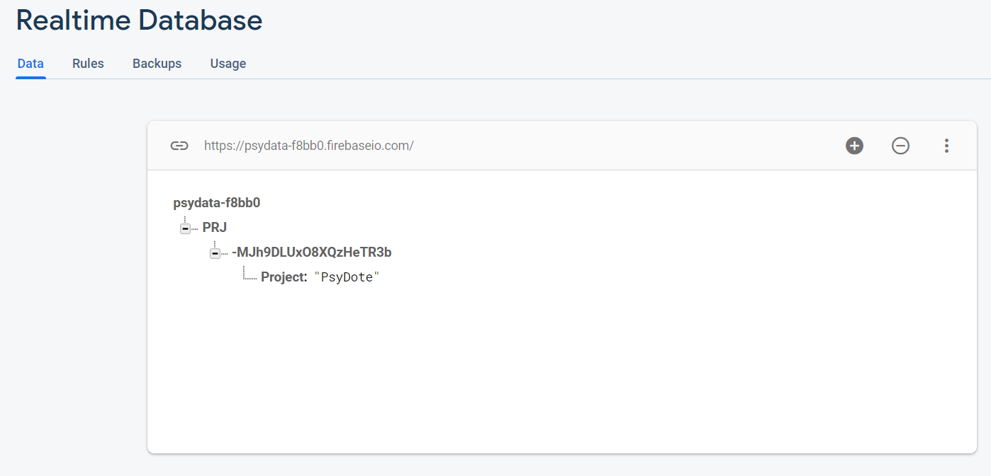
RealTime Database
A RealTime DataBase is created for storing the Triggers,further which is connected with the android application for triggering and helping the victim.

Slide 17
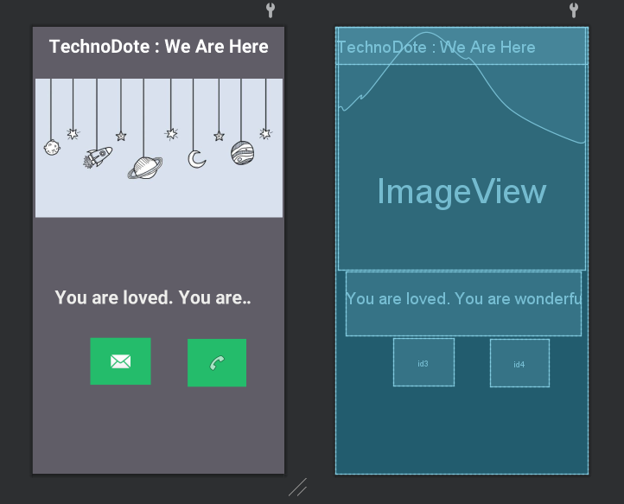
User Interface

Slide 18
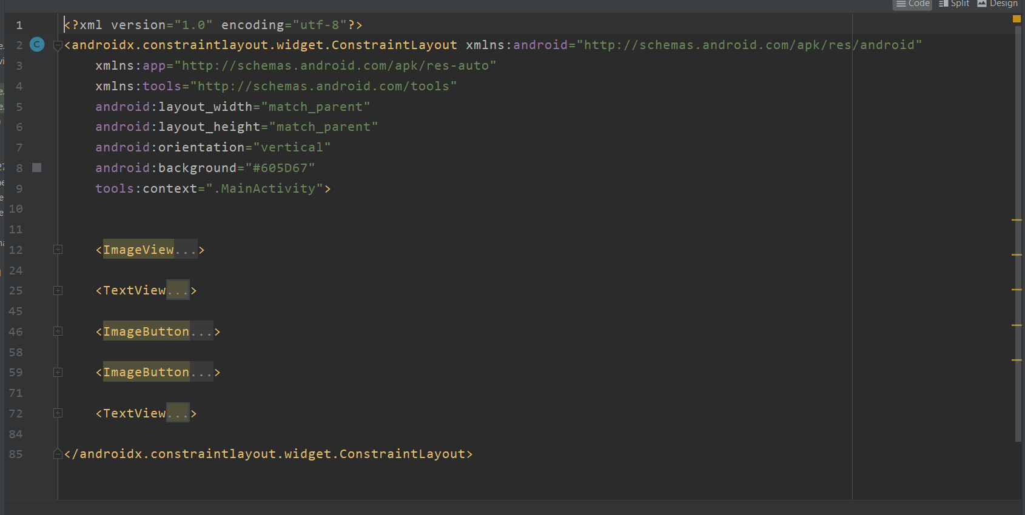

Slide 19
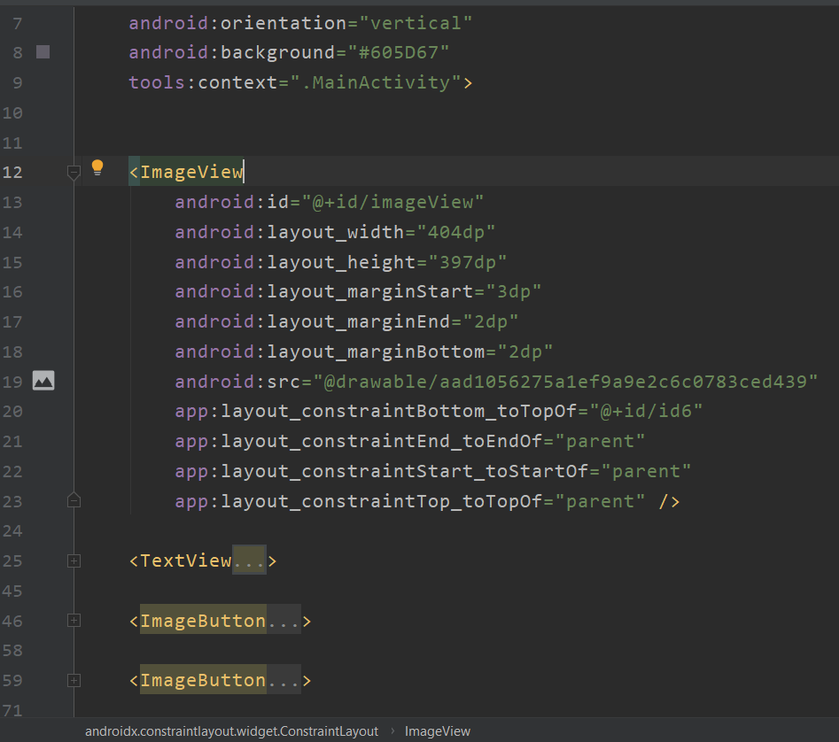
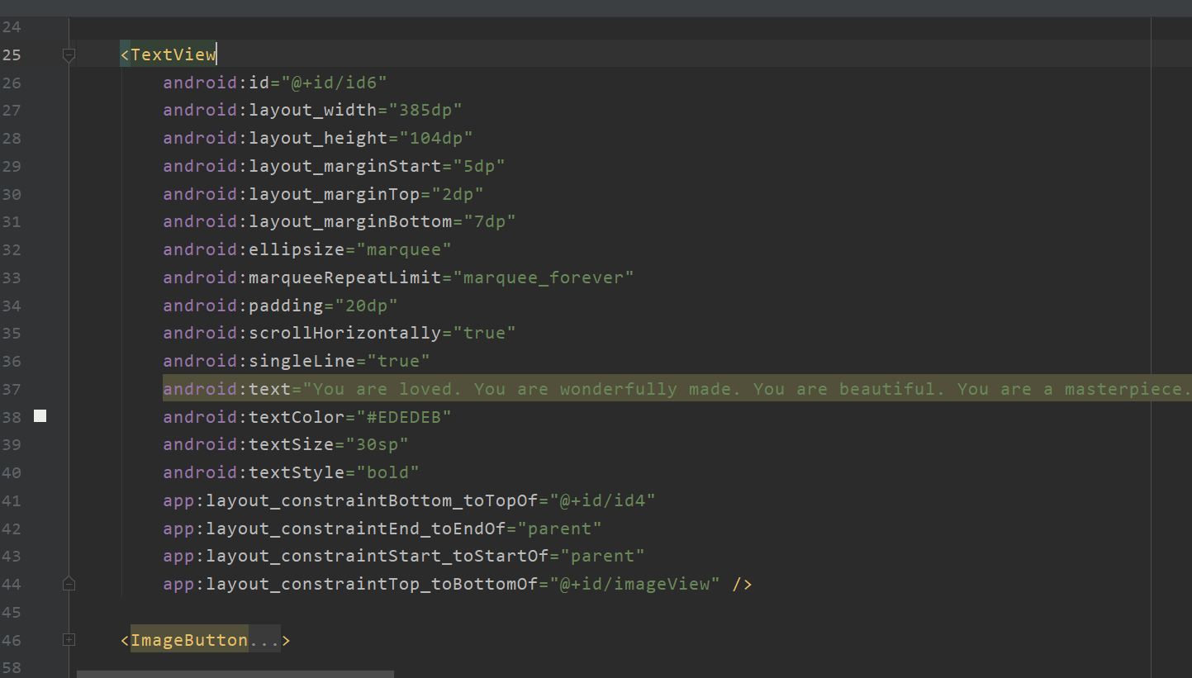

Slide 20
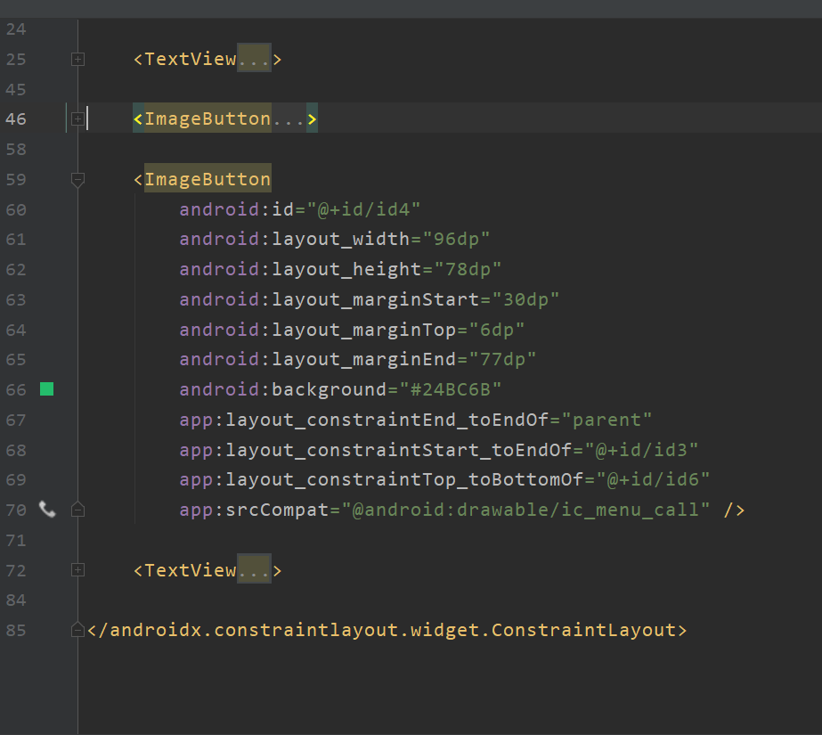
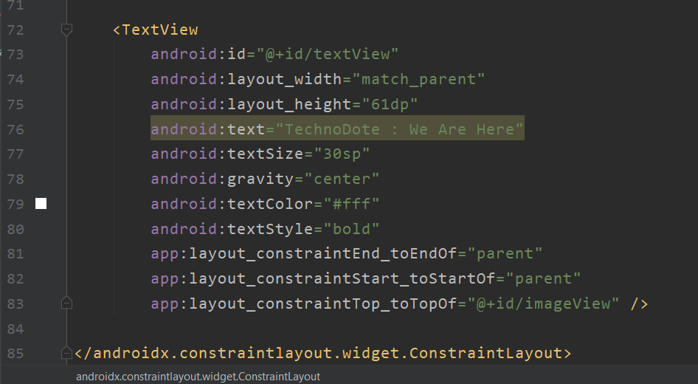

Slide 21
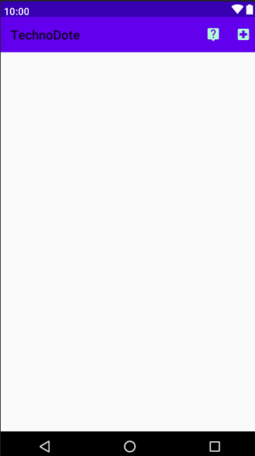
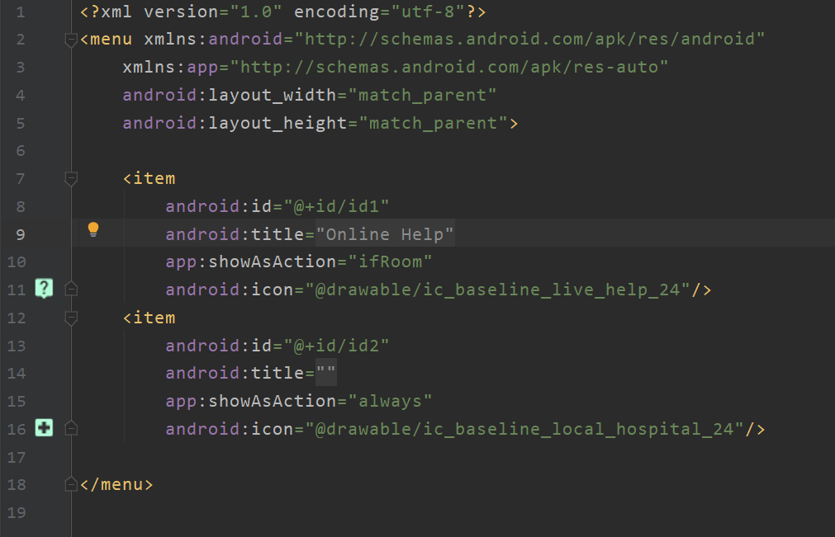
MENU layout

Slide 22
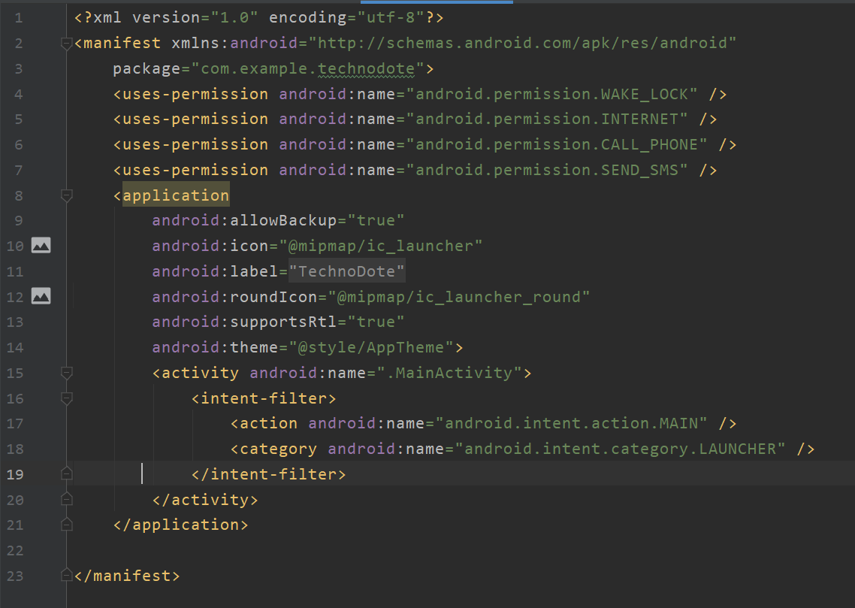
MANIFEST

Slide 23
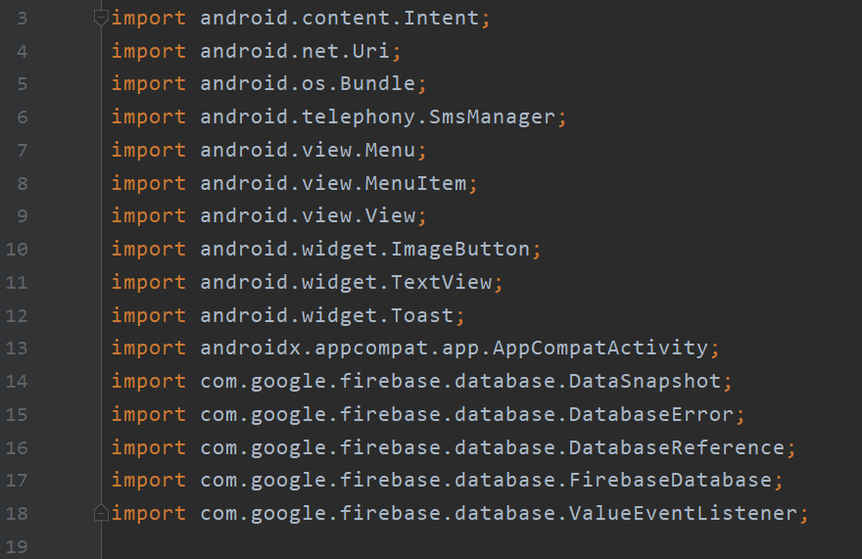
JAVA code- Imports

Slide 24
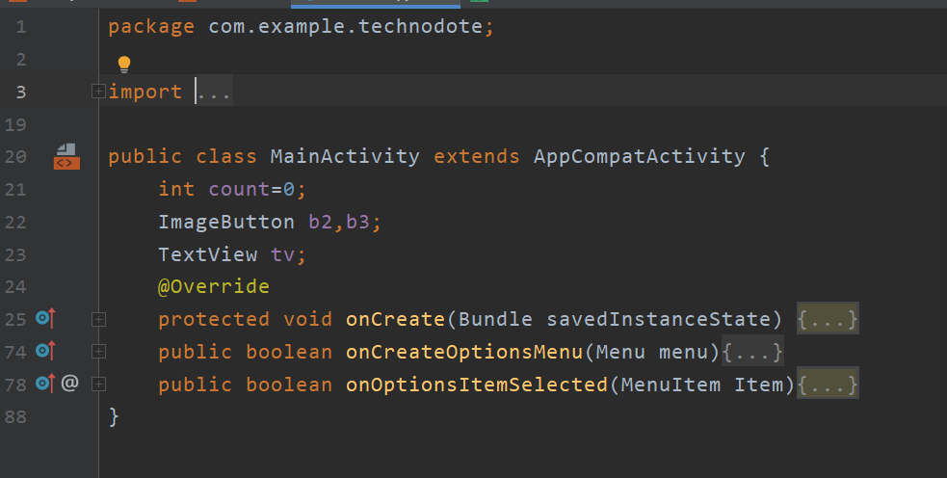
JAVA code

Slide 25
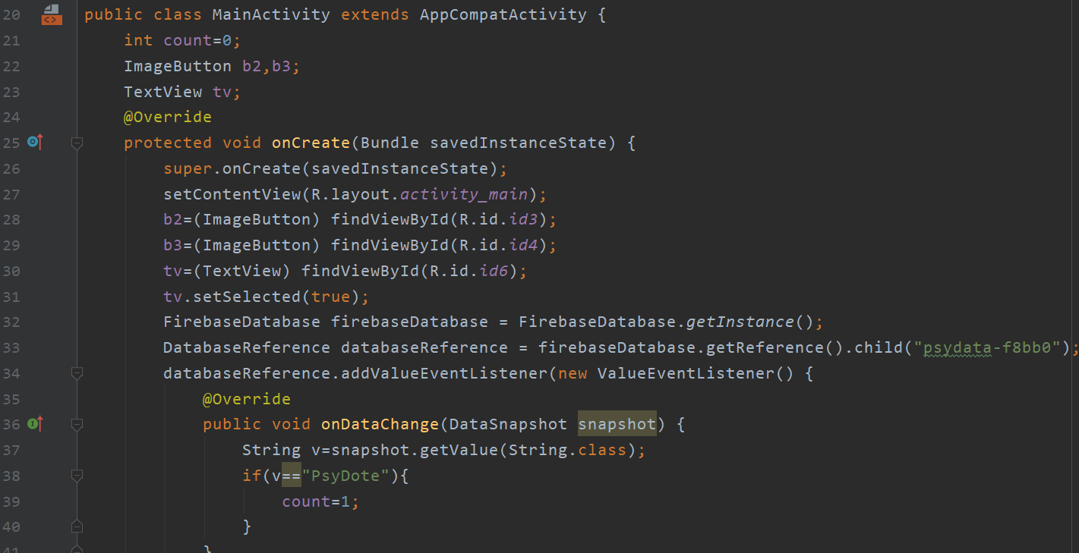

Slide 26
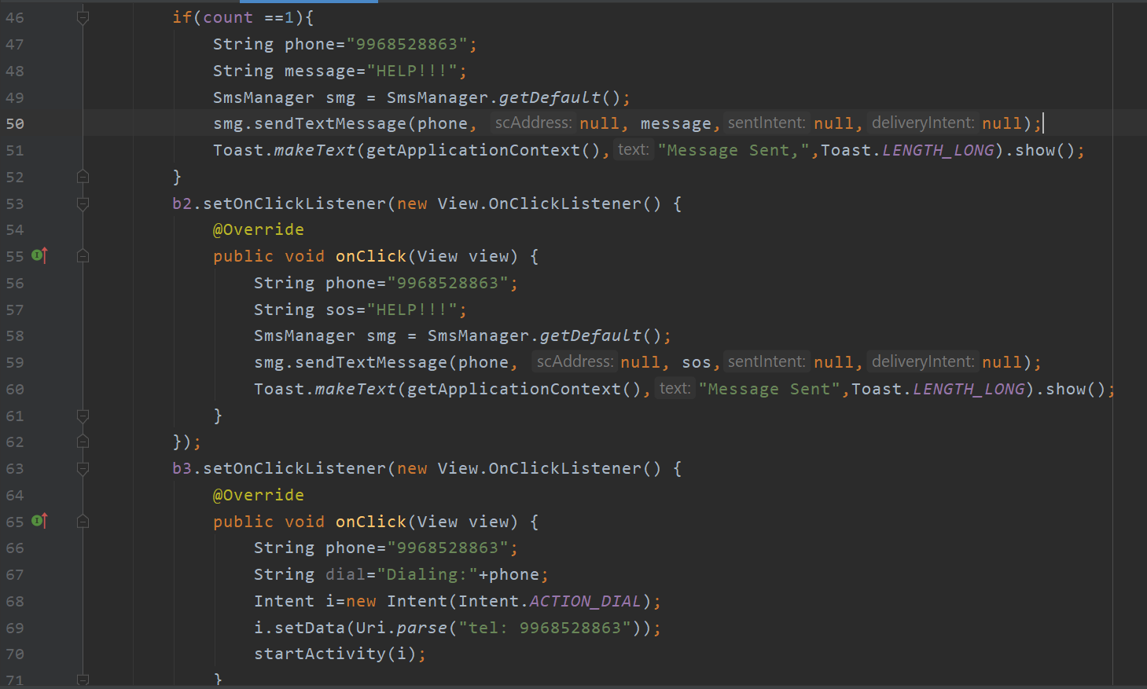

Slide 27
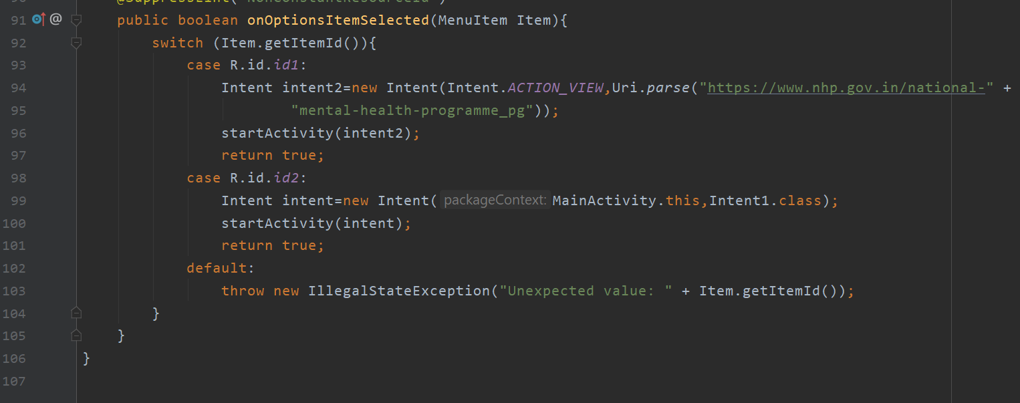

Slide 28
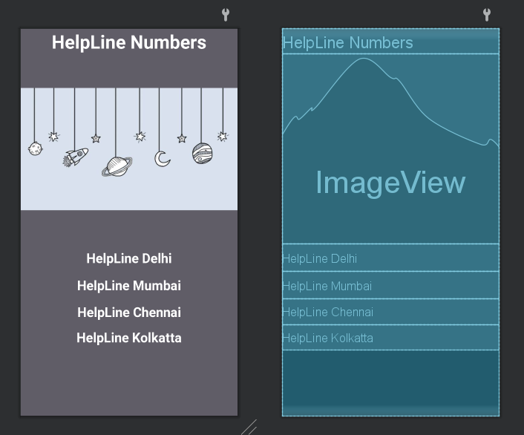
INTENT ACTIVITY

Slide 29
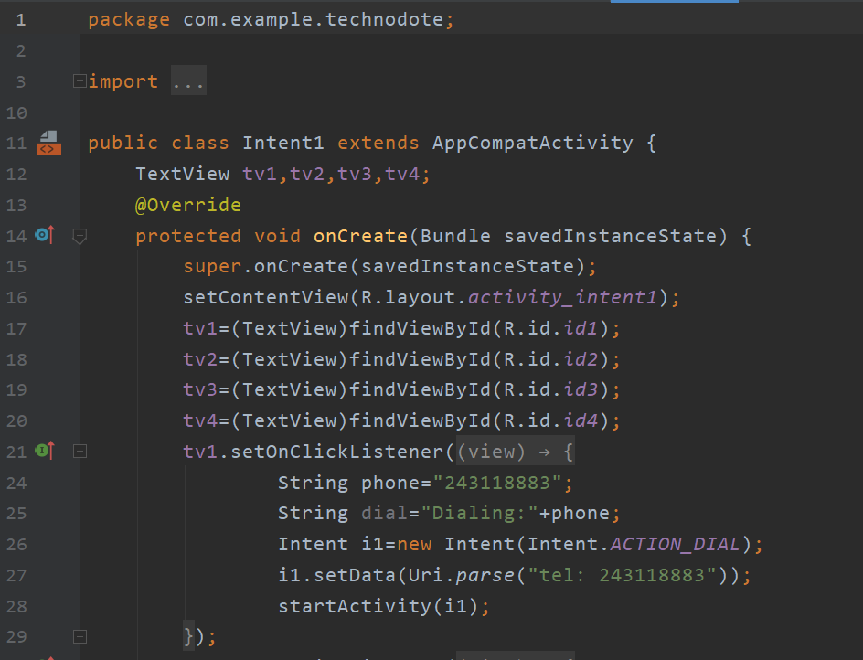
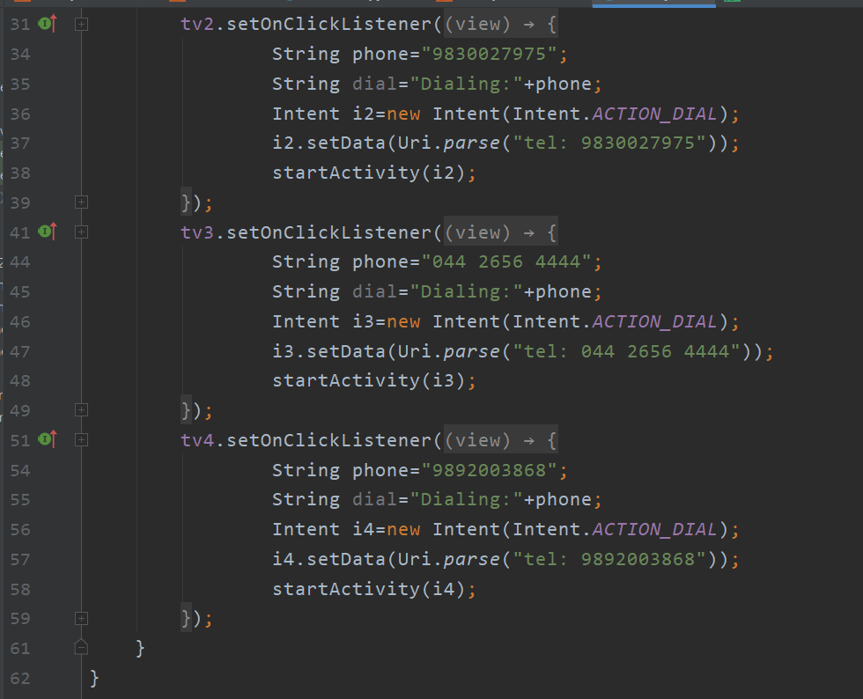

Slide 30
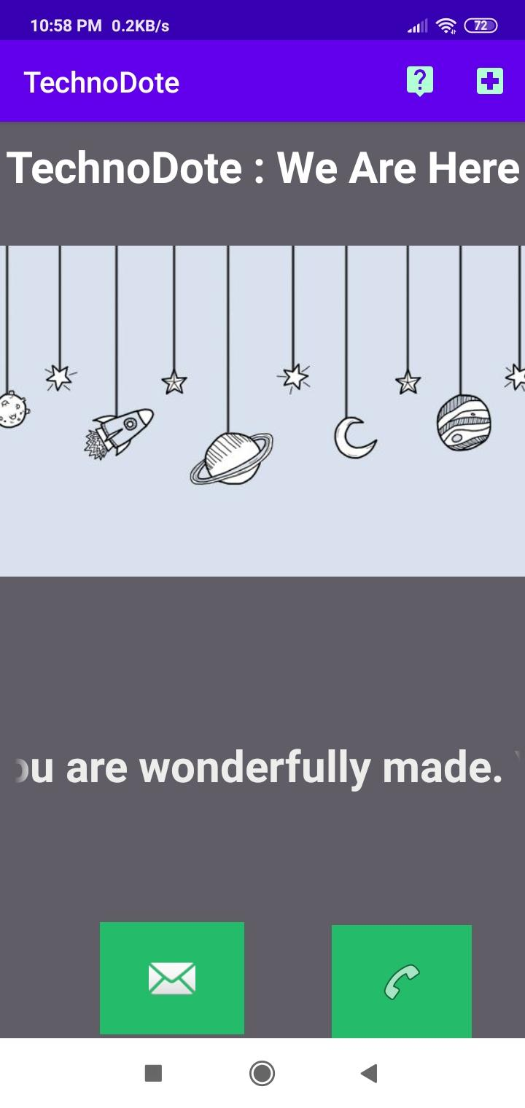
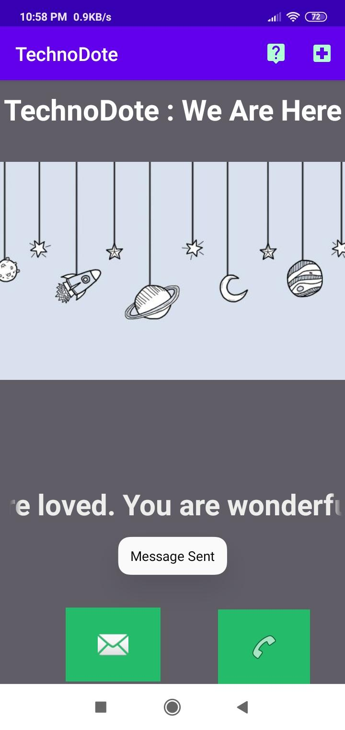
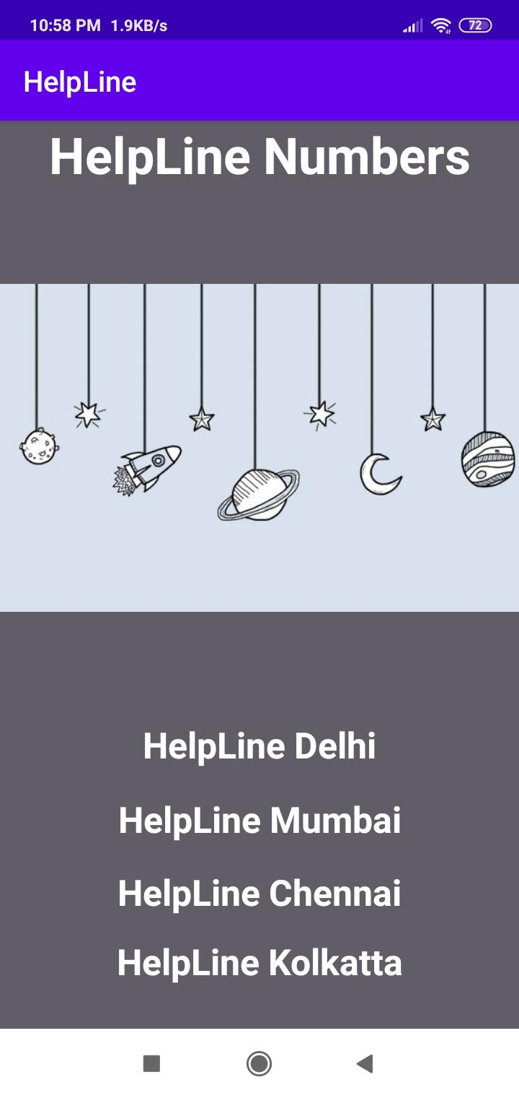
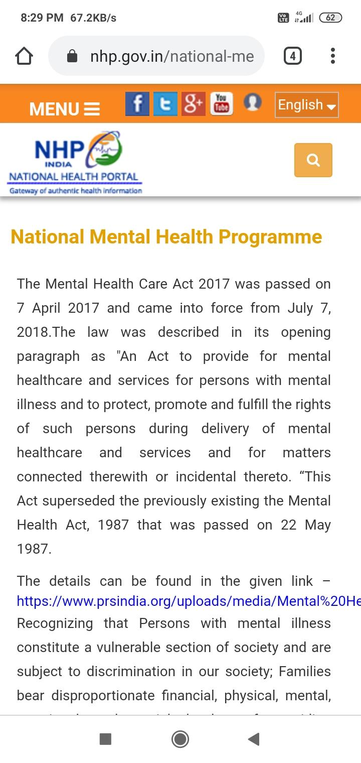
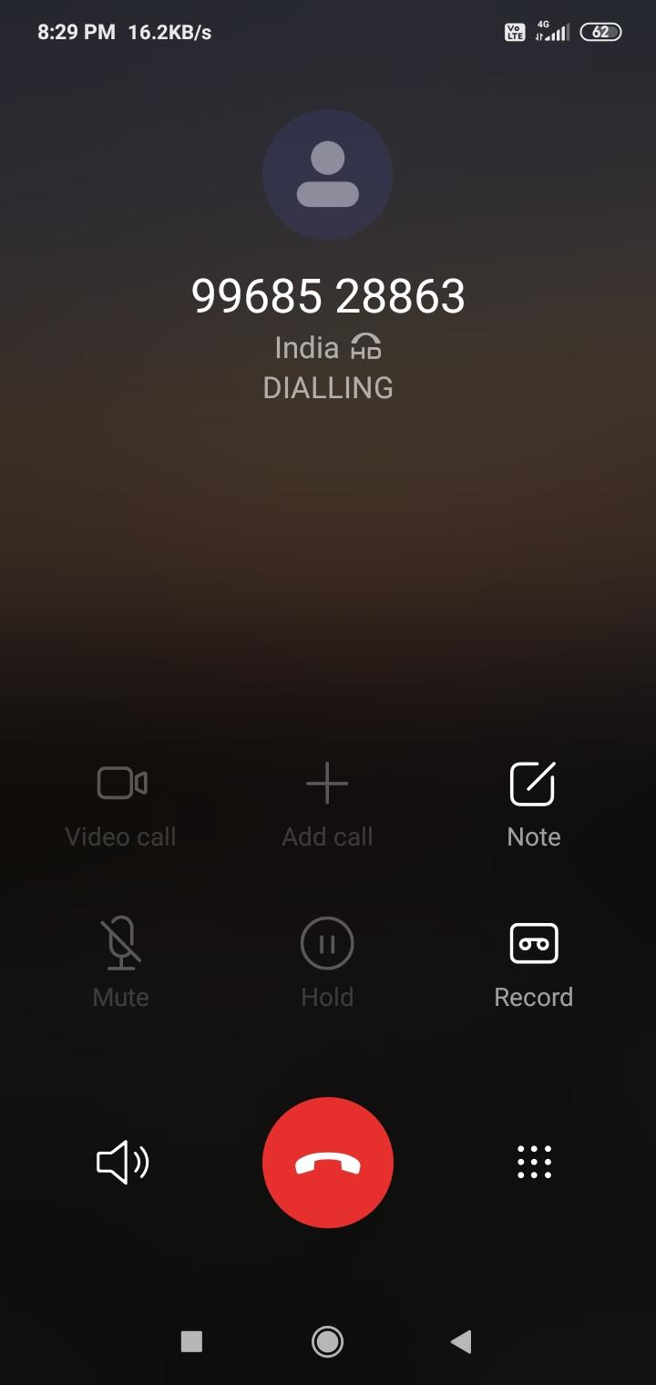
SNAPSHOT OF PROJECT
Notes:
shubham

Slide 31

TESTING

Slide 32
RESULT AND DISCUSSION
The program gives an output for the TWEETDATA containing approx 3500 tweets and gives output for 1900+ suspicious tweets for mental health issues. The application provides a supportive SOS call and message function with special helpline numbers for MAHANAGAR cities and an online help and support system from the government.

